Slide 1

Building a C-Based Chat Server
This presentation will explore the design and implementation of a chat server developed in C, showcasing its capabilities for real-time communication and file sharing.

Slide 2




Presentation Overview
System Architecture
Key Features
Understanding the foundational components.
Exploring messaging and file transfer.
Implementation Details
Challenges & Solutions
Diving into the C codebase.
Overcoming common network programming hurdles.

Slide 3
Server Architecture: The Core Hub
Multi-Client Handling
The server is designed to manage up to 10 concurrent clients, utilizing a thread-per-client model to ensure responsive and independent client interactions.
Socket Init
(WSAStartup,
Create Socket)
Connect to Server
(IP, Port)
Main Loop - Handle Input - Send/Receive
User Input
Cleanup (Close Socket, Files, WSACleanup)
Message Handling (Send/Receive)
Receive File
(Header, Save)
Send File Module
(Header, Data)
SERVER
A critical section protects shared resources, preveting race conditions during client management and message broadcasting. This ensures data integrity and system stability under load.

Slide 4
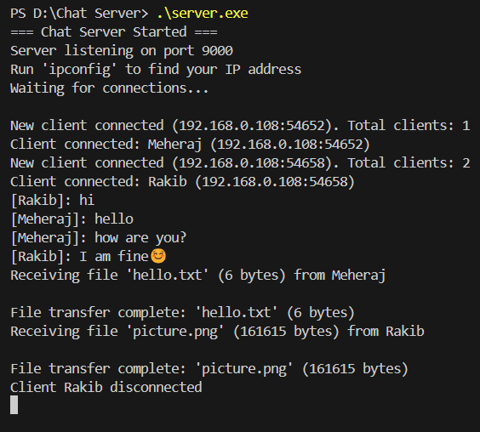
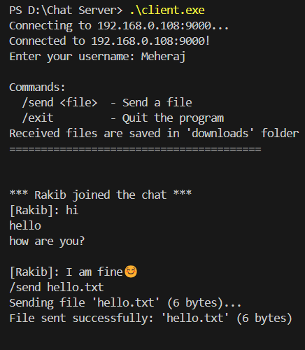
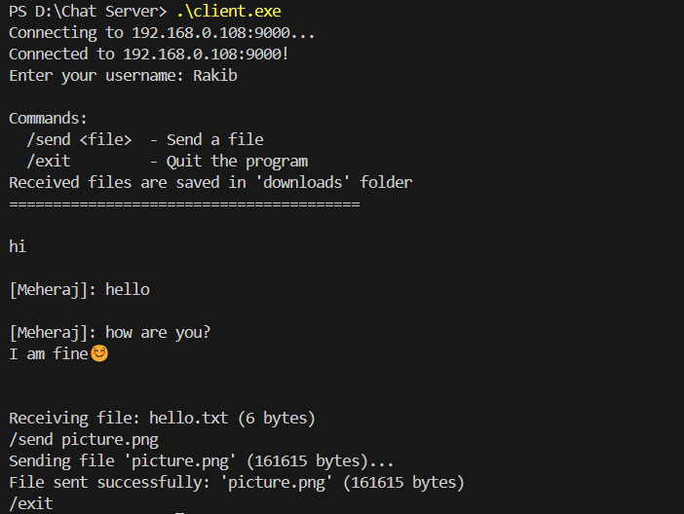
Client-Server Communication Flow
Messages travel seamlessly between clients and the server. When a user sends a message, it's relayed through the server, ensuring efficient and reliable delivery to all intended recipients, regardless of their device.
server terminal
client - 1
client - 2

Slide 5
Client-Server Communication Flow
Connection Initiation
1
Clients connect via TCP sockets, providing a reliable, ordered, and error-checked stream of data. The server then assigns a dedicated thread for each connection.
2
Username Exchange
Upon successful connection, clients send their chosen username to the server, which is then used for message identification across the network.
Message & File Handling
3
The server continuously monitors for incoming messages or file transfer requests, distinguishing between them based on a predefined header.
4
Disconnection Management
Proper handling of client disconnections, including resource cleanup and broadcasting departure notifications to remaining users.

Slide 6

Real-time Messaging & File Transfer
1
Broadcast Messaging
Messages are formatted with the sender's username and broadcast to all connected clients, excluding the sender, ensuring a dynamic chat environment.
2
File Transfer Protocol
Files are sent with a "FILE:[filename]:[filesize]\n" header, allowing the server and clients to manage transfers efficiently.

Slide 7
Implementation Details: C & WinSock
WinSock2.h
Provides core network programming functions for Windows environments, including socket creation, binding, listening, and sending/receiving data.
WSAGetLastError()
Crucial for debugging and error handling, providing specific error codes for network operations, essential for robust server and client applications.
_beginthreadex()
Used for creating client-handling threads, enabling the server to process multiple simultaneous client connections without blocking.
CRITICAL_SECTION
Ensures thread safety when accessing shared data structures like the client list, preventing data corruption from concurrent modifications.
ioctlsocket()
Sets client sockets to non-blocking mode (FIONBIO), allowing the client to simultaneously send input and receive messages without waiting.

Slide 8




Key Challenges & Solutions
Concurrency Control
Partial File Transfers
Implemented Critical Sections to manage shared resources and prevent race conditions, particularly for client list modifications.
Developed robust loops for `send` and `recv` operations, ensuring complete file transmission by handling partial sends/receives.
Network Configuration
Error Handling
Provided clear instructions for firewall exceptions and IP address discovery (`ipconfig`) to simplify client connectivity.
Integrated `WSAGetLastError()` extensively for detailed error reporting, facilitating debugging and improving application stability.

Slide 9
Conclusion
Project Accomplishments
Successfully built a functional chat server with real-time messaging and file transfer capabilities.
Gained hands-on experience with C, WinSock API, and multi-threading for network applications.
Demonstrated robust error handling and concurrency control in a networked environment.
Presentation by,
Meheraj Alam
email: ce23039@mbstu.ac.bd
github: github.com/Meherajs

